Slide 1
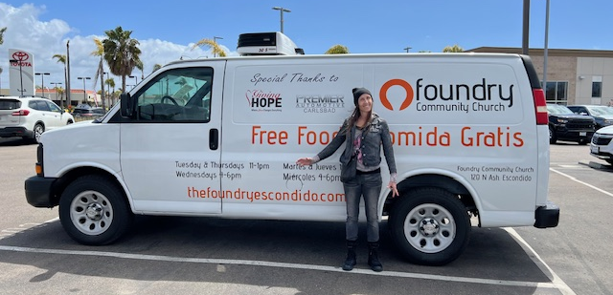
The Foundry Food Pantry

Slide 2
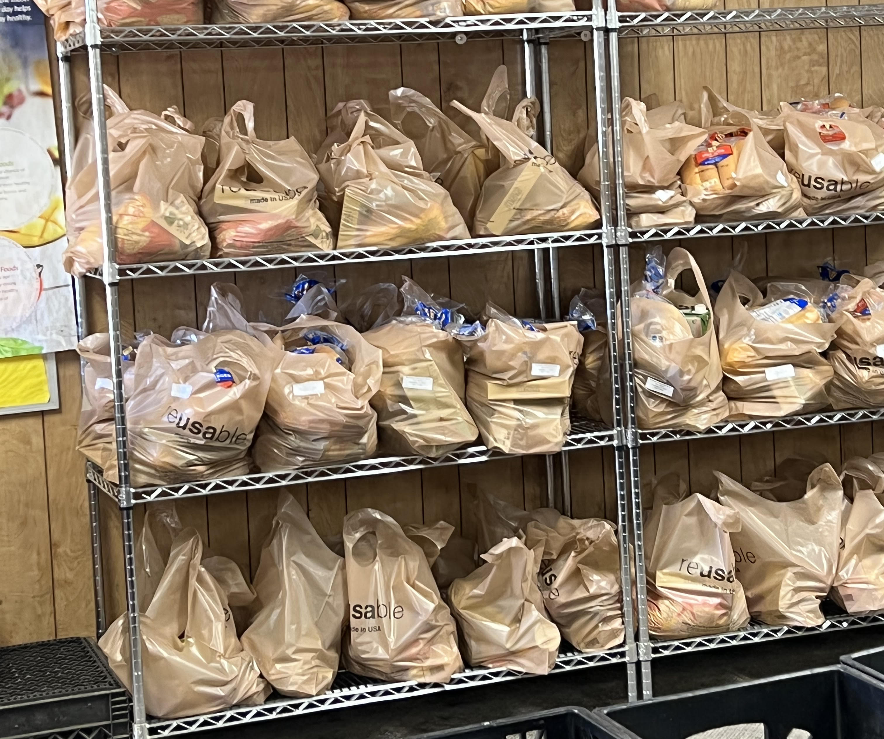
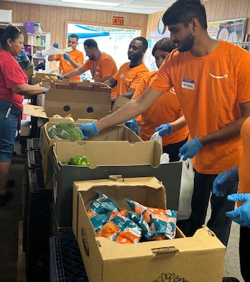
What we distribute

Slide 3
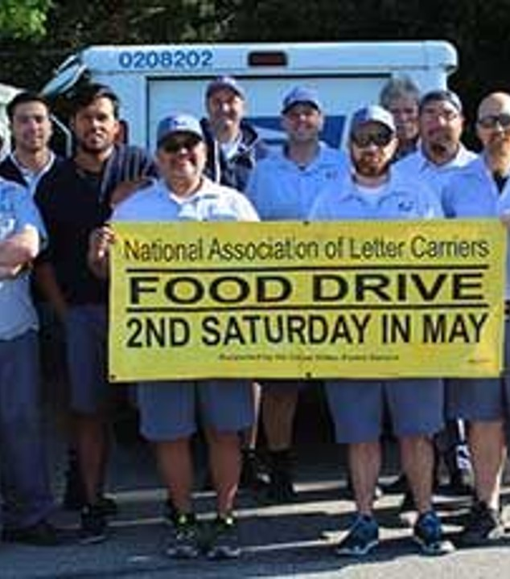
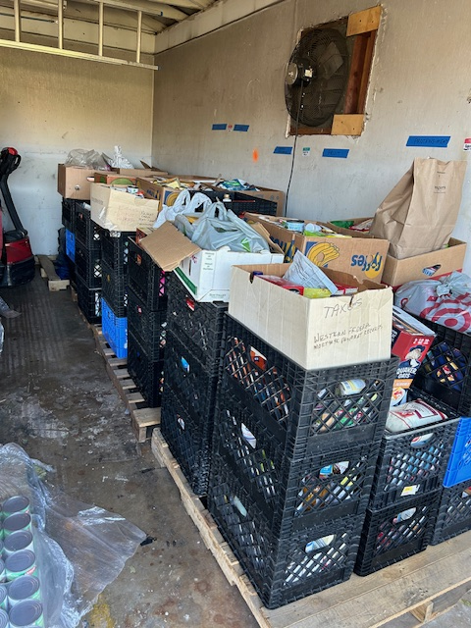
Stamp Out Hunger 2024

Slide 4
Some Pantry Statistics
Number of households served in 2025: 21,971
Number of Diapers/Feminine Hygiene Products distributed in 2025:
  6,769 Packs of Diapers
  2,186 Packs of Wipes
  6,561 Feminine Hygiene Supplies
Pounds of food rescued from stores: 155,000

Slide 5
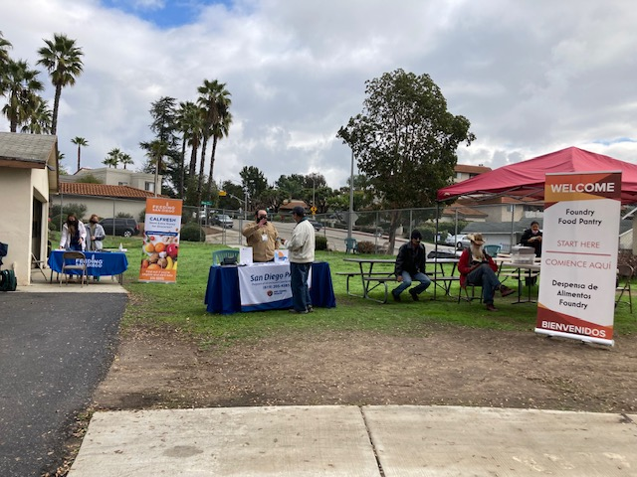
On Site Partners

Slide 6
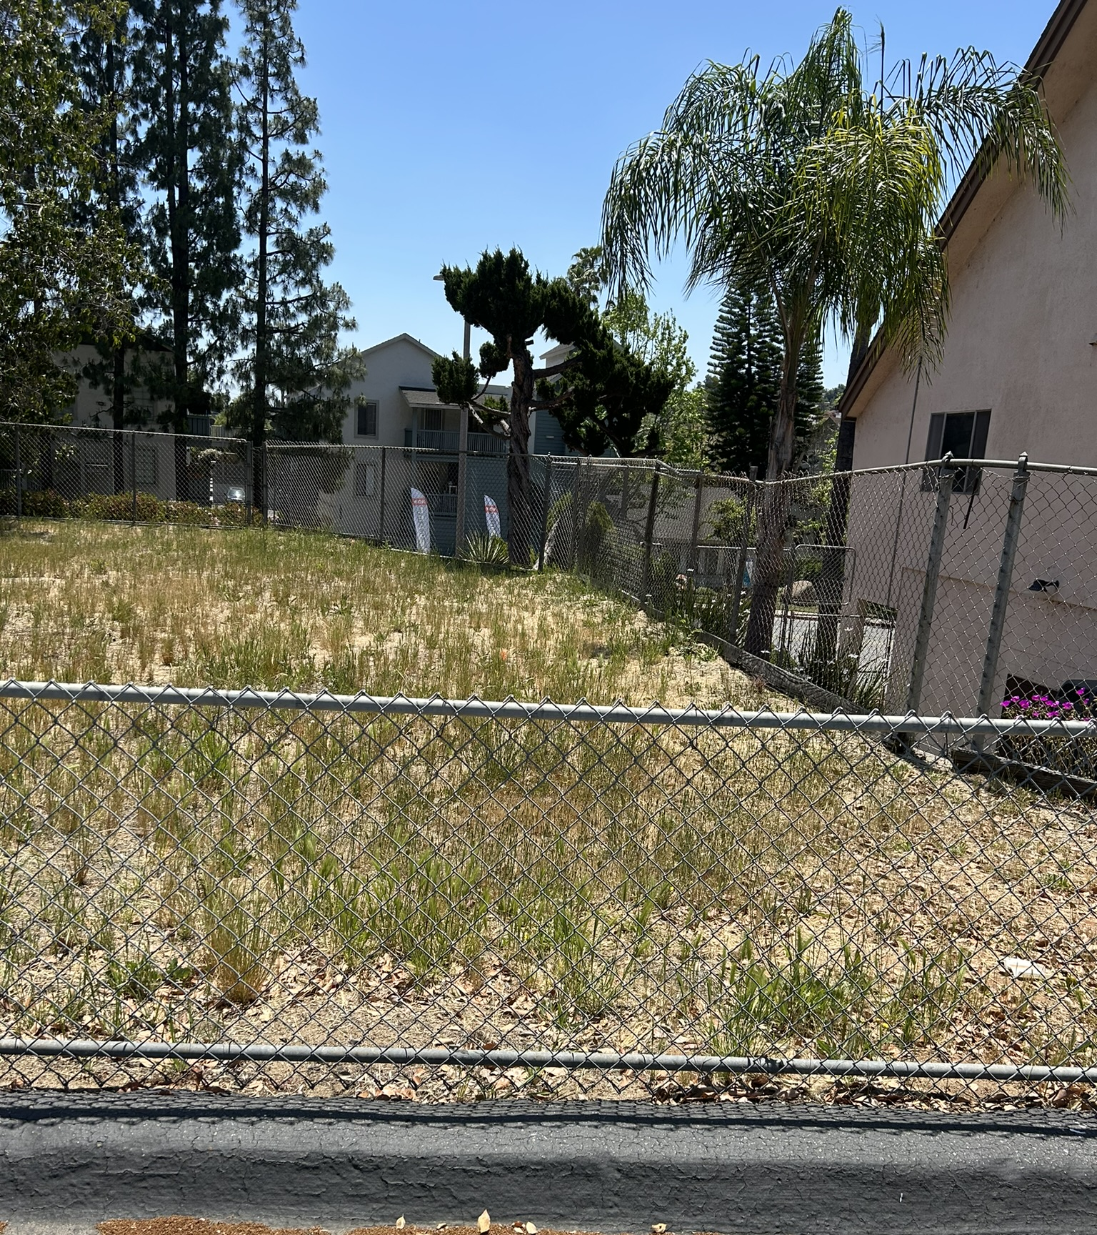
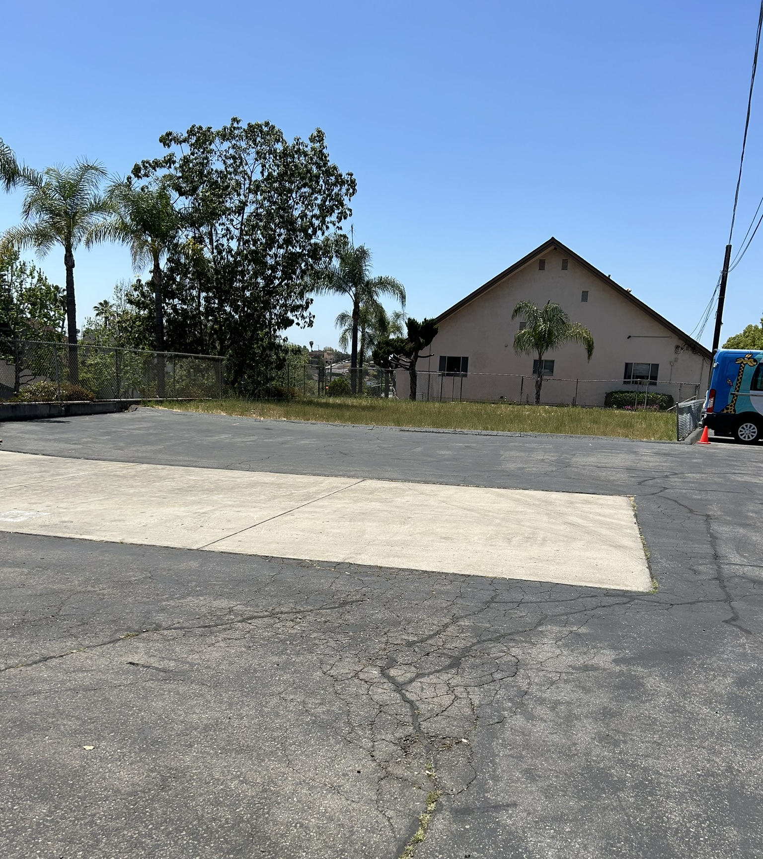
New Food Pantry Building

